Slide 1


Slide 2
Lecture By Arjun Pukale

Slide 3
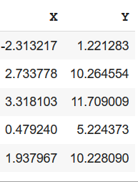

Linear Regression
Data
………. …………

Slide 4
Linear Regression
Data
Y contains real values
………. …………

Slide 5
Linear Regression
Notations:
Data
m=Total data points (total no. of rows)
n=Total no. of columns in X (n=1 in this eg)
Can represent each row as (xi , yi)
Where i denotes the row number
Eg (x2,y2)=(2.733778,10.264554)
………. …………

Slide 6
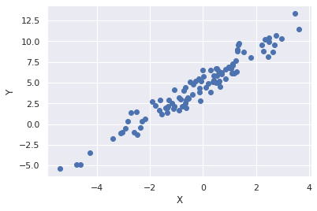
Linear Regression
Data
………. …………

Slide 7
Linear Regression
Data
Training
Linear Regression
Model
………. …………

Slide 8
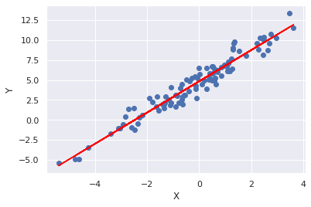
Linear Regression
Data
Training
Linear Regression
Model
………. …………

Slide 9
Model

Slide 10
Model
Predict output at x=-2

Slide 11
Model
Predict output at x=-2

Slide 12


Slide 13
Slope
Y-intercept

Slide 14

weight
bias

Slide 16
There may be many such lines

Slide 17
There may be many such lines
Which one to choose?

Slide 18
There may be many such lines
Which one to choose?
Choose the line with best fit

Slide 19
There may be many such lines
Which one to choose?
Choose the line with best fit
What is best fit?

Slide 20
There may be many such lines
Which one to choose?
Choose the line with best fit
What is best fit?
The average distance between line and all the points should be minimum

Slide 21
Loss Function

Slide 22
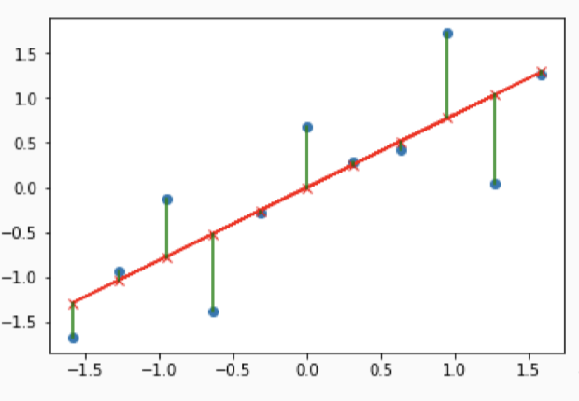
Loss Function
error

Slide 23
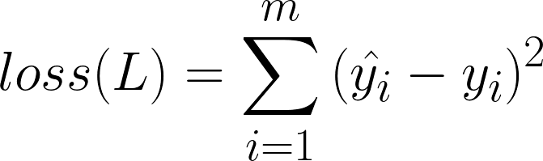

Loss Function
predicted
Total no of points in data
actual
error
Squared Error Loss

Slide 24
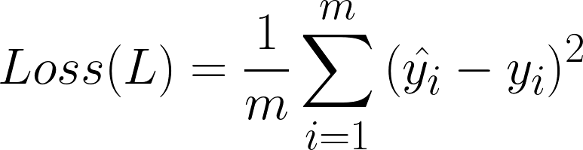
Loss Function
error
Mean Squared Error Loss

Slide 25
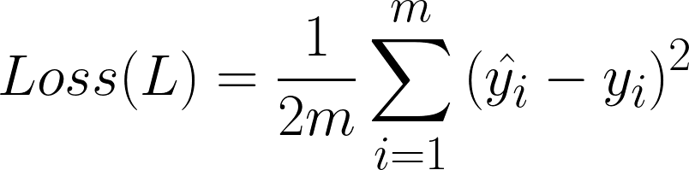
Loss Function
error
Mean Squared Error Loss

Slide 26

Randomly initialised: w and b
X | Y
-1.5 | -2 | -1.5
-1.25 | -1 | -0.8
-1 | 0 | -0.7
-0.75 | -1.5 | -0.8
-0.2 | -0.5 | -0.25
0 | 0.7 | 0.3
…… | …… | ……
Loss depends on w,b

Slide 27
X | Y
-1.5 | -2 | -1.7
-1.25 | -1 | -0.9
-1 | 0 | -0.3
-0.75 | -1.5 | -1.2
-0.2 | -0.5 | -0.3
0 | 0.7 | 0.4
…… | …… | ……
Loss depends on w,b
Update w,b such that Loss is reduced

Slide 28
X | Y
-1.5 | -2 | -1.8
-1.25 | -1 | -1
-1 | 0 | -0.2
-0.75 | -1.5 | -1.3
-0.2 | -0.5 | -0.35
0 | 0.7 | 0.6
…… | …… | ……
Loss depends on w,b
Update w,b such that Loss is reduced

Slide 29
X | Y
-1.5 | -2 | -1.8
-1.25 | -1 | -1
-1 | 0 | -0.2
-0.75 | -1.5 | -1.3
-0.2 | -0.5 | -0.35
0 | 0.7 | 0.6
…… | …… | ……
Loss depends on w,b
Update w,b such that Loss is reduced
Goal: Find optimum value of w,b such that Loss is minimum

Slide 30



